Slide 1
Your First Program
Python with Robots Mission 2
Lesson 2 Objectives 6-10

Slide 2

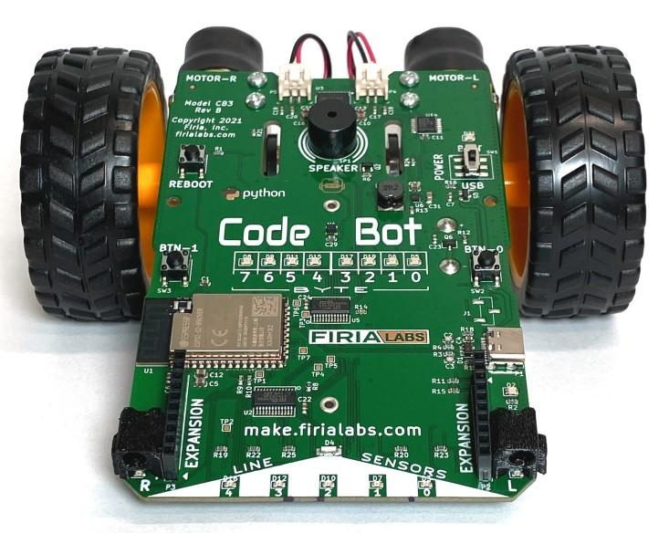
Pre-Mission Warm-Up
In your Mission 2 Lesson 2 log, answer the first pre-mission warm-up question:
What are some peripherals on CodeBot?

Slide 3


Pre-Mission Warm-Up
In your Mission 2 Lesson 2 log, answer the second pre-mission warm-up question:
What is the difference between inputs and outputs?

Slide 4
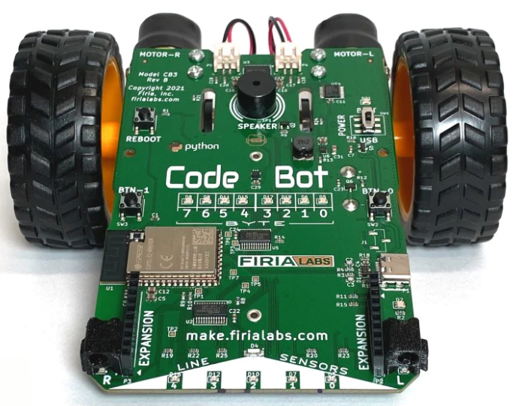
Objective #6: Connect the USB
Locate the USB connector on CodeBot.
Connecting CodeBot to the computer using a USB cable does two things:
  It lets the computer communicate with CodeBot, such as loading the program on its CPU.
  It provides power to CodeBot.

Slide 5
Objective #6: Connect the USB
Use the USB cable to connect CodeBot to your computer.
If a window pops up, you can close it.

Slide 6
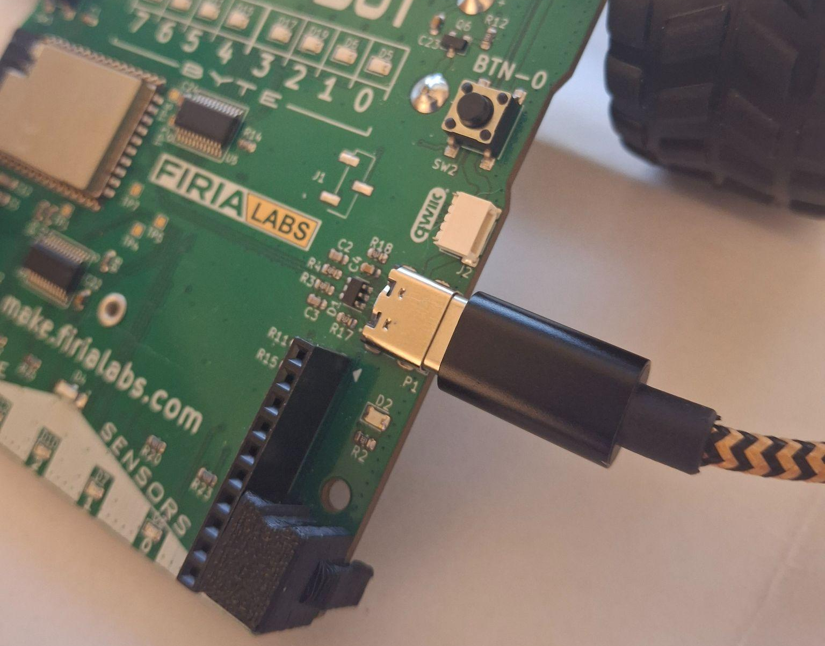
Objective #6 Activity
DO THIS:
Close the Objective Panel.
Click on the USB connection port in the simulator.
Use a USB cable to connect the CodeBot to the computer.

Slide 7
Objective #7: Link to CodeSpace
The first time you use a CodeBot, you may have to link it to CodeSpace.
When you plug in the USB cable, a window may pop up. If it does, just close it.
Follow the steps to link your connected CodeBot to CodeSpace.

Slide 8
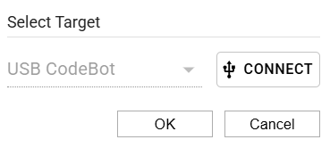
Objective #7 Activity
DO THIS:
Use a USB cable to connect CodeBot to the computer.
Look in the lower left corner.
Click on the red bar:
Make sure the Target is USB CodeBot.
Click CONNECT.
Then click OK.
The bar should now show:

Slide 9
Objective #8: Save the Code!
You will type all your code in the text editor.
The code is automatically saved, all the time, as you type.
The file is saved in your personal file-system in the CodeSpace cloud.
DO THIS:
Answer the two questions in your mission log.

Slide 10
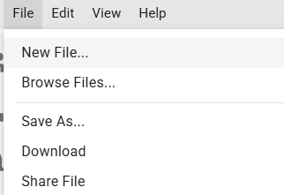
Objective #8 Activity
DO THIS:
Create a new file.
Click on “FILE” and then select “New File”.
Call the file: LightsOn
The name must be spelled exactly the same (no spaces).

Slide 11
Objective #9: The CodeTrek
CodeTrek is like your own tutor in CodeSpace. It will:
Give you a starting point for your program.
Give information about lines of code and what they do.
Give explanations of coding topics.
Give you # TODO: comments where you fill in your own code.
DO THIS:
Answer the first question in your mission log.

Slide 12
Objective #9: The CodeTrek
Comments are notes that the computer ignores.
You write a comment to remind yourself why you write specific code, or to explain what a section of code does.
You don’t have to type the comments in CodeTrek; you can add your own comments!
A comment starts with a hashtag # and will turn green.
DO THIS:
Answer the second question in your mission log.

Slide 13
Objective #9: The CodeTrek
A # TODO: is a standard reminder comment.
It tells you there is still work to do!
When you see # TODO: in CodeTrek, do not type it.
Instead, type the actual code that accomplishes the task.
DO THIS:
Answer the third question in your mission log.

Slide 14


Objective #9 Activity
DO THIS:
Click on the Hint and read it. Then close the Hint.
Click on CodeTrek.
Read both messages in CodeTrek.
You do not need to type the code (yet).
Close CodeTrek.

Slide 15
Objective #10: Lights On!
Now it is time for you to type in some code!
Caution: Capitalization matters!
Code is case sensitive.
That means that Number is not the same as number.
DO THIS:
Answer the first two questions in your mission log.

Slide 16
Objective #10 Activity
The first line of code is an import statement.
Other programmers have written blocks of code that perform common actions.
These blocks of code are called objects and functions.
The functions are packaged in a “library” or “module” and can be imported and used by other programmers.
When you import a library, you have access to all the objects and functions in that library.
You can also import a single object or function from a library.

Slide 17
Objective #10 Activity
The second line of code uses a function from the library to turn on a user LED.
You need to give the number of the LED.
Looking at your CodeBot, the LED to the far right (close to BTN-0) is 0.
The user LED to the far left (close to BTN-1) is 7.
Give the Boolean value True to turn it on, and the Boolean value False to turn it off.

Slide 18

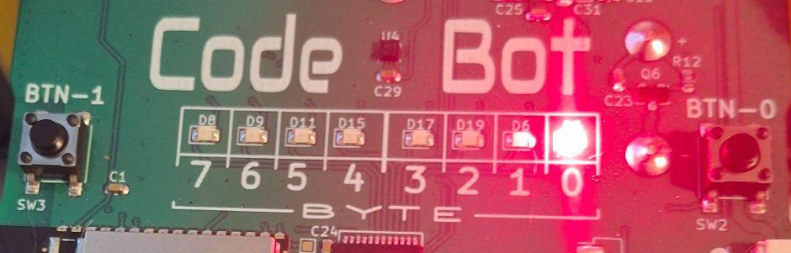
Objective #10 Activity
DO THIS:
Open CodeTrek and type the two lines of code.
Read the section “Run It!” for more information about user LEDs.
Run the code.
Answer the last two questions on your mission log.

Slide 19
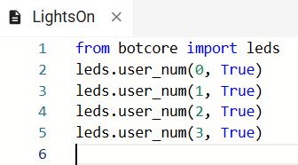
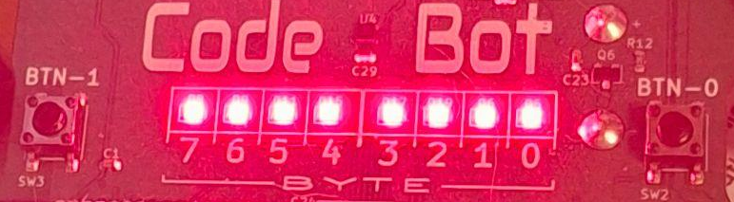
Objective #10 Challenge
DO THIS:
Add code to your program so that all the user LEDs are turned on.
Hint: Although you cannot copy and paste from CodeTrek, you can copy and paste in the text editor.

Slide 20
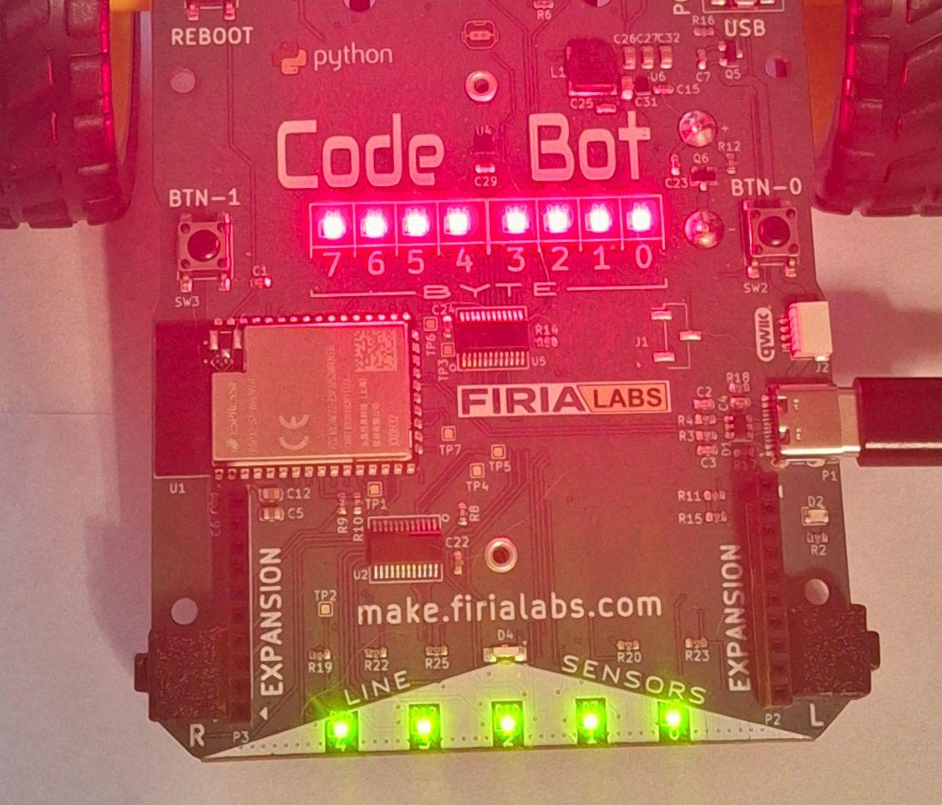
Objective #10 Challenge
DO THIS:
Add code to your program so that all the line sensor LEDs are turned on.
Line sensor LEDs are numbered 0-4.
Hint: The code for turning on a line sensor LED is
  leds.ls_num(0, True)

Slide 21
Objective #10 Challenge
DO THIS:
Come up with your own pattern of user and line sensor LEDs.

Slide 22
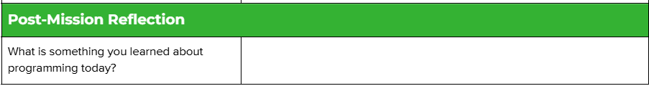
Post-Mission Reflection
Complete the post-mission reflection in your Mission 2 Lesson 2 Log

